Slide 2
3D blade model updating by coupling HAWC2 and ABAQUS
Maria Luz Castilla Mena (s212601@dtu.dk)
Notes:
Hi, I am Maria and I am going to present my master thesis topic: Evolution of blade cracks with wind turbine simulation tolos (this is a provisional titile, it needs to be discussed)

Slide 3
INDEX
From last meeting
Progress of the project
For the next meeting

Slide 4

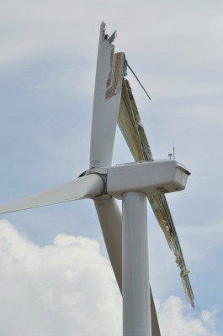
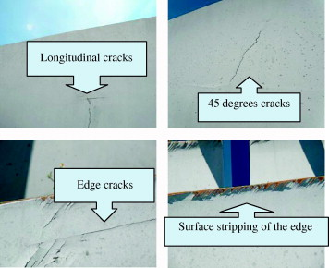
Introduction to the topic
Weak section
Vo
Notes:
Wind turbines are exposed to external conditions that can deteriorate its performance. In the aeroelastic context of a wind turbine, both the aerodynamic forces and the structural flexibility influence each other. The aerodynamic forces can make the blades suffer deformations and fractures may occur, and these deformations change the aerodynamic forces.

Slide 5
Problem approach
HAWC2
Abaqus
MATLAB
Notes:
3 softwares will be used to study the evolution of cracks that may appear in the blades due to the change in aerodynamic forces. Using the HAWC2 software, an aeroelastic wind turbine simulation tool, the aerodynamic forces are calculated and will be used in the ABAQUS software to calculate the deformation of the material and the new stiffness components, which will be needed again in the HAWC2 software to update the aerodynamic forces. Both softwares communicate with each other through MATLAB. A time simulation will be carried out using simultaneously the 3 softwares to study the evolution of cracks in the blades under certain external conditions.

Slide 6
From last meeting

Slide 7
From last meeting
Get ABAQUS to recognise the loads generated by HAWC2
Approach:
Convert loads from .sel file (HAWC2) to .inp file so ABAQUS can recognise them
In ABAQUS: Dynamic analysis with applied moment in the free end
The moment should follow the variation of the HAWC2 loads
Project Plan due 7th September

Slide 8

From last meeting
Get ABAQUS to recognise the loads generated by HAWC2
Approach:
Convert loads from .sel file (HAWC2) to .inp file so ABAQUS can recognise them
In ABAQUS: Dynamic analysis with applied moment in the free end
The moment should follow the variation of the HAWC2 loads
Project Plan due 7th September

Slide 9
Progress of the project

Slide 10
Progress of the project
Get Abaqus to read an .inp file with the aerodynamic data from HAWC2
Subtasks:
Modify HAWC2 output file (.sel) to only get blade outputs (moments in time)
Create an .inp file with the data from HAWC2 in MATLAB
Create a simple beam model to simulate the blade structures
Import the created .inp file in Abaqus and see if it recognises the input

Slide 11


Progress of the project
Continue with the MATLAB interface to make the update of the loads automatic
MATLAB code that updates loads
MATLAB code that opens updated .inp file in ABAQUS
MATLAB code that gets the outputs from .dat file generated by ABAQUS

Slide 12
Results

Slide 13
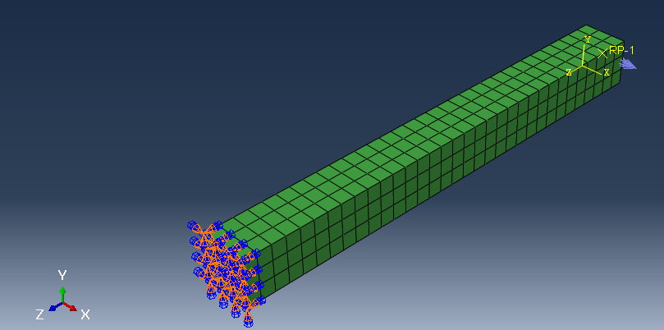
Moment in Abaqus

Slide 14
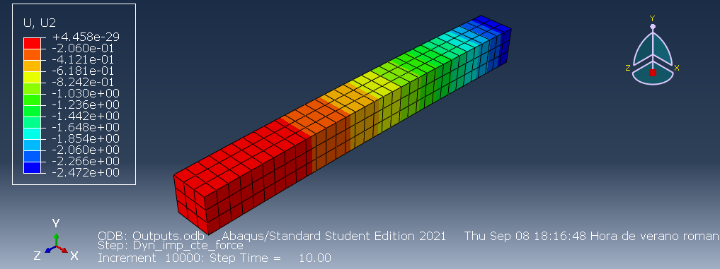
Updated moment in Abaqus

Slide 15
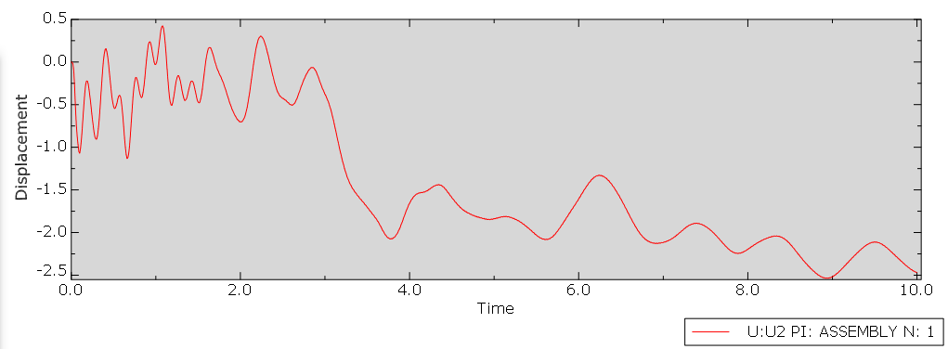
Displacement reference point (free end)

Slide 16
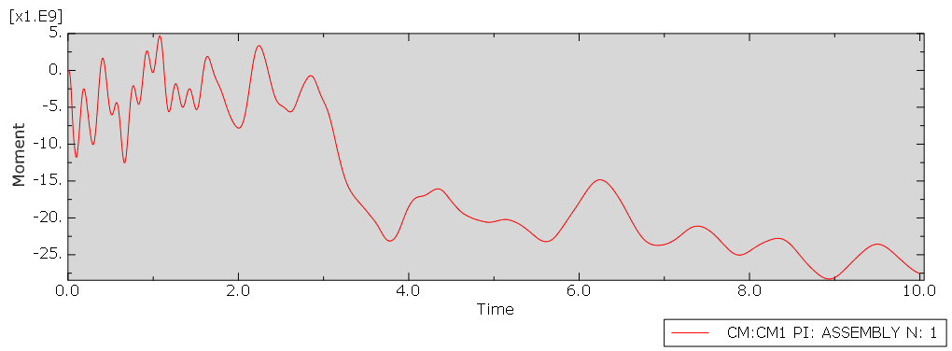
Moment applied in reference point (free end)

Slide 17
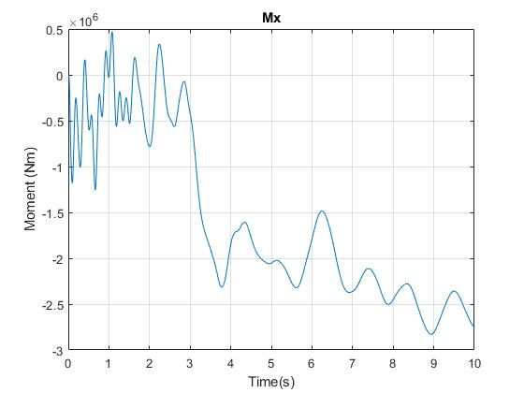
Moment: HAWC2 output
Notes:
Numbers not the same because in abaqus the amplitud is scaled by 10000 (really stiff, if not the results were too small to notice)

Slide 18
MATLAB interface
When loading the amplitude from the .inp file, the amplitude values are displayed in the .inp file
Trying to delete them so that it does not interfere with the current load .inp file that I am updating
Trying to add *NODE PRINT lines so I can save the results in MATLAB

Slide 19
For next meeting…

Slide 20
For the next meeting
Use Abaqus full version?
Finish developing MATLAB code that saves outputs from ABAQUS
.dat file should show outputs: *Node print
Recall how to get the stiffness matrix for isotropic material -NO
Suggestions?

